Slide 1
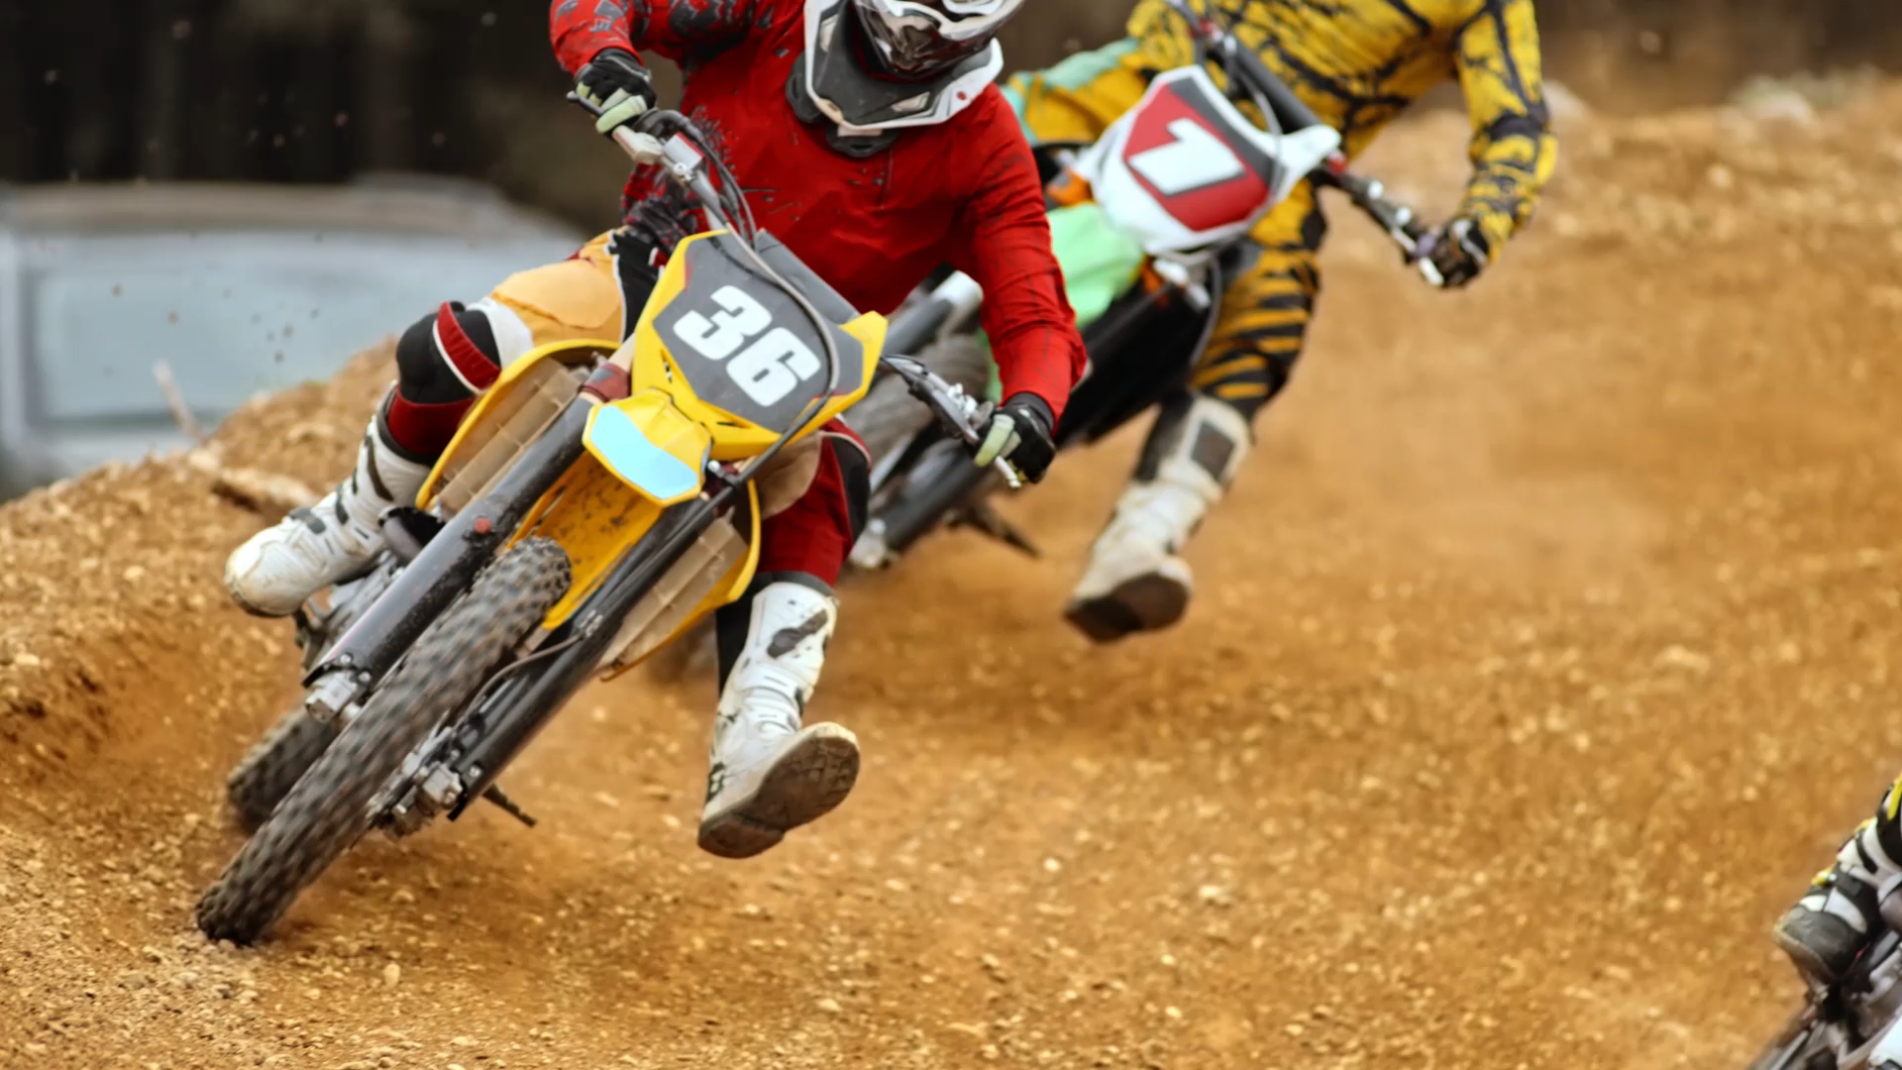
Cult Racing
Gruppe 1: Jonny, Jann, Xu, Christopher, Nicola

Slide 2
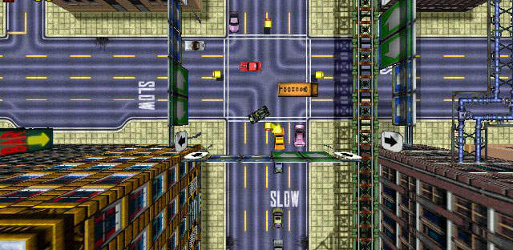
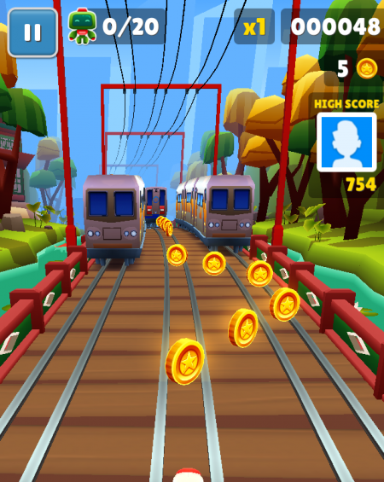
Inspiration
Gta 1
Subway Surfer

Slide 3
Milestone 1
Login {xu}
Register {Yann}
Basic-Seite (Play Button) {Nicola}
Base-Game (Browser Große) {Jonathan}
Data-Base {Christoher}

Slide 4
Milestone 2
Chat
Points
Ranking
Profil ändern
Map Browser Size

Slide 5
Milestone 3
Game Map Extension (y)
Camera
Friend-List
More Cars

Slide 6
Milestone 4
Game Map Extension (x+y)

Slide 7
Final
Ranking
Chat
Friend list
Profile
Game:
Map
Obstacles
Cars
Camera
(Power-ups)

